Slide 1
THANK YOU FOR DOWNLOADING!
Hope it helps with your presentations!
In case the embedded fonts don’t work, here are the download links:
Cinzel
https://fonts.google.com/specimen/Cinzel
Inter https://www.fontsquirrel.com/fonts/inter
@DSTORYCO
www.dstory.co

Slide 2
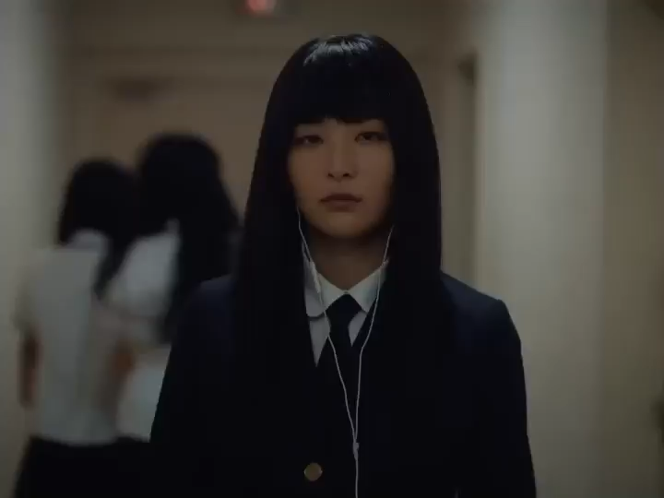
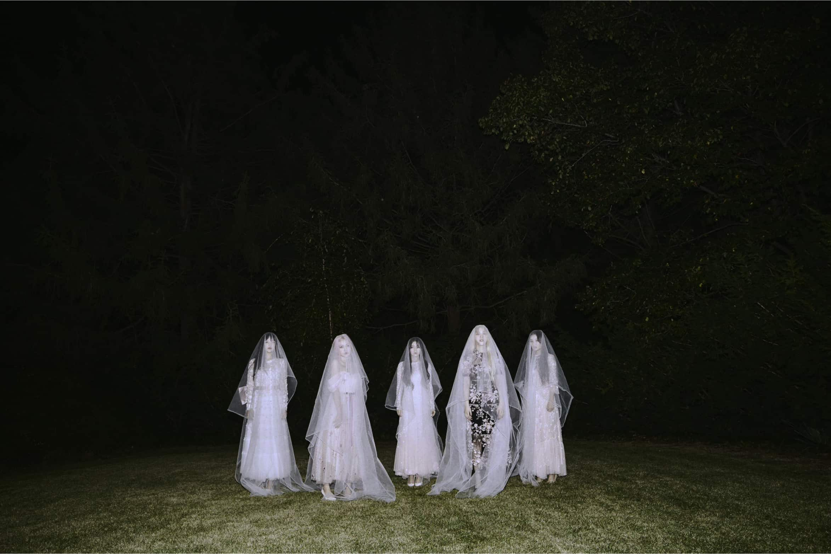
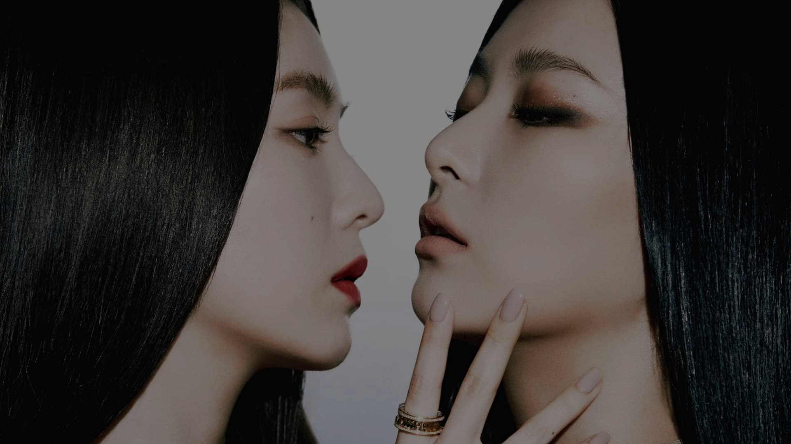
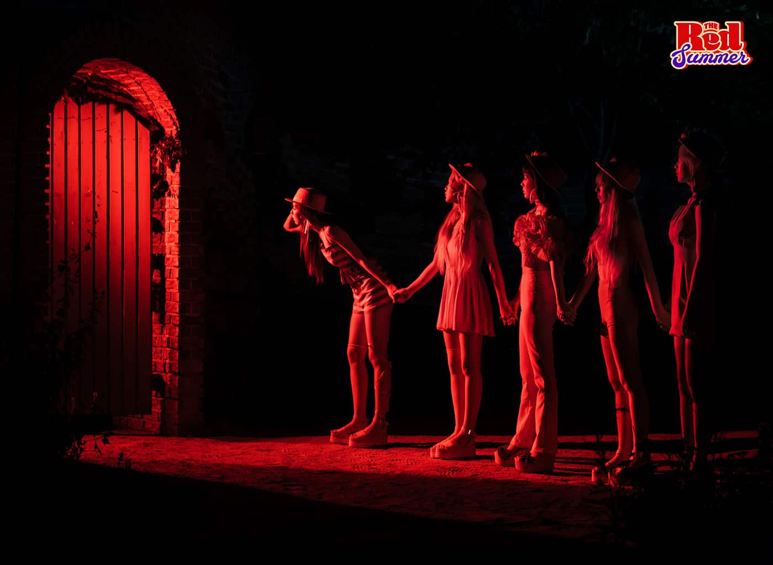
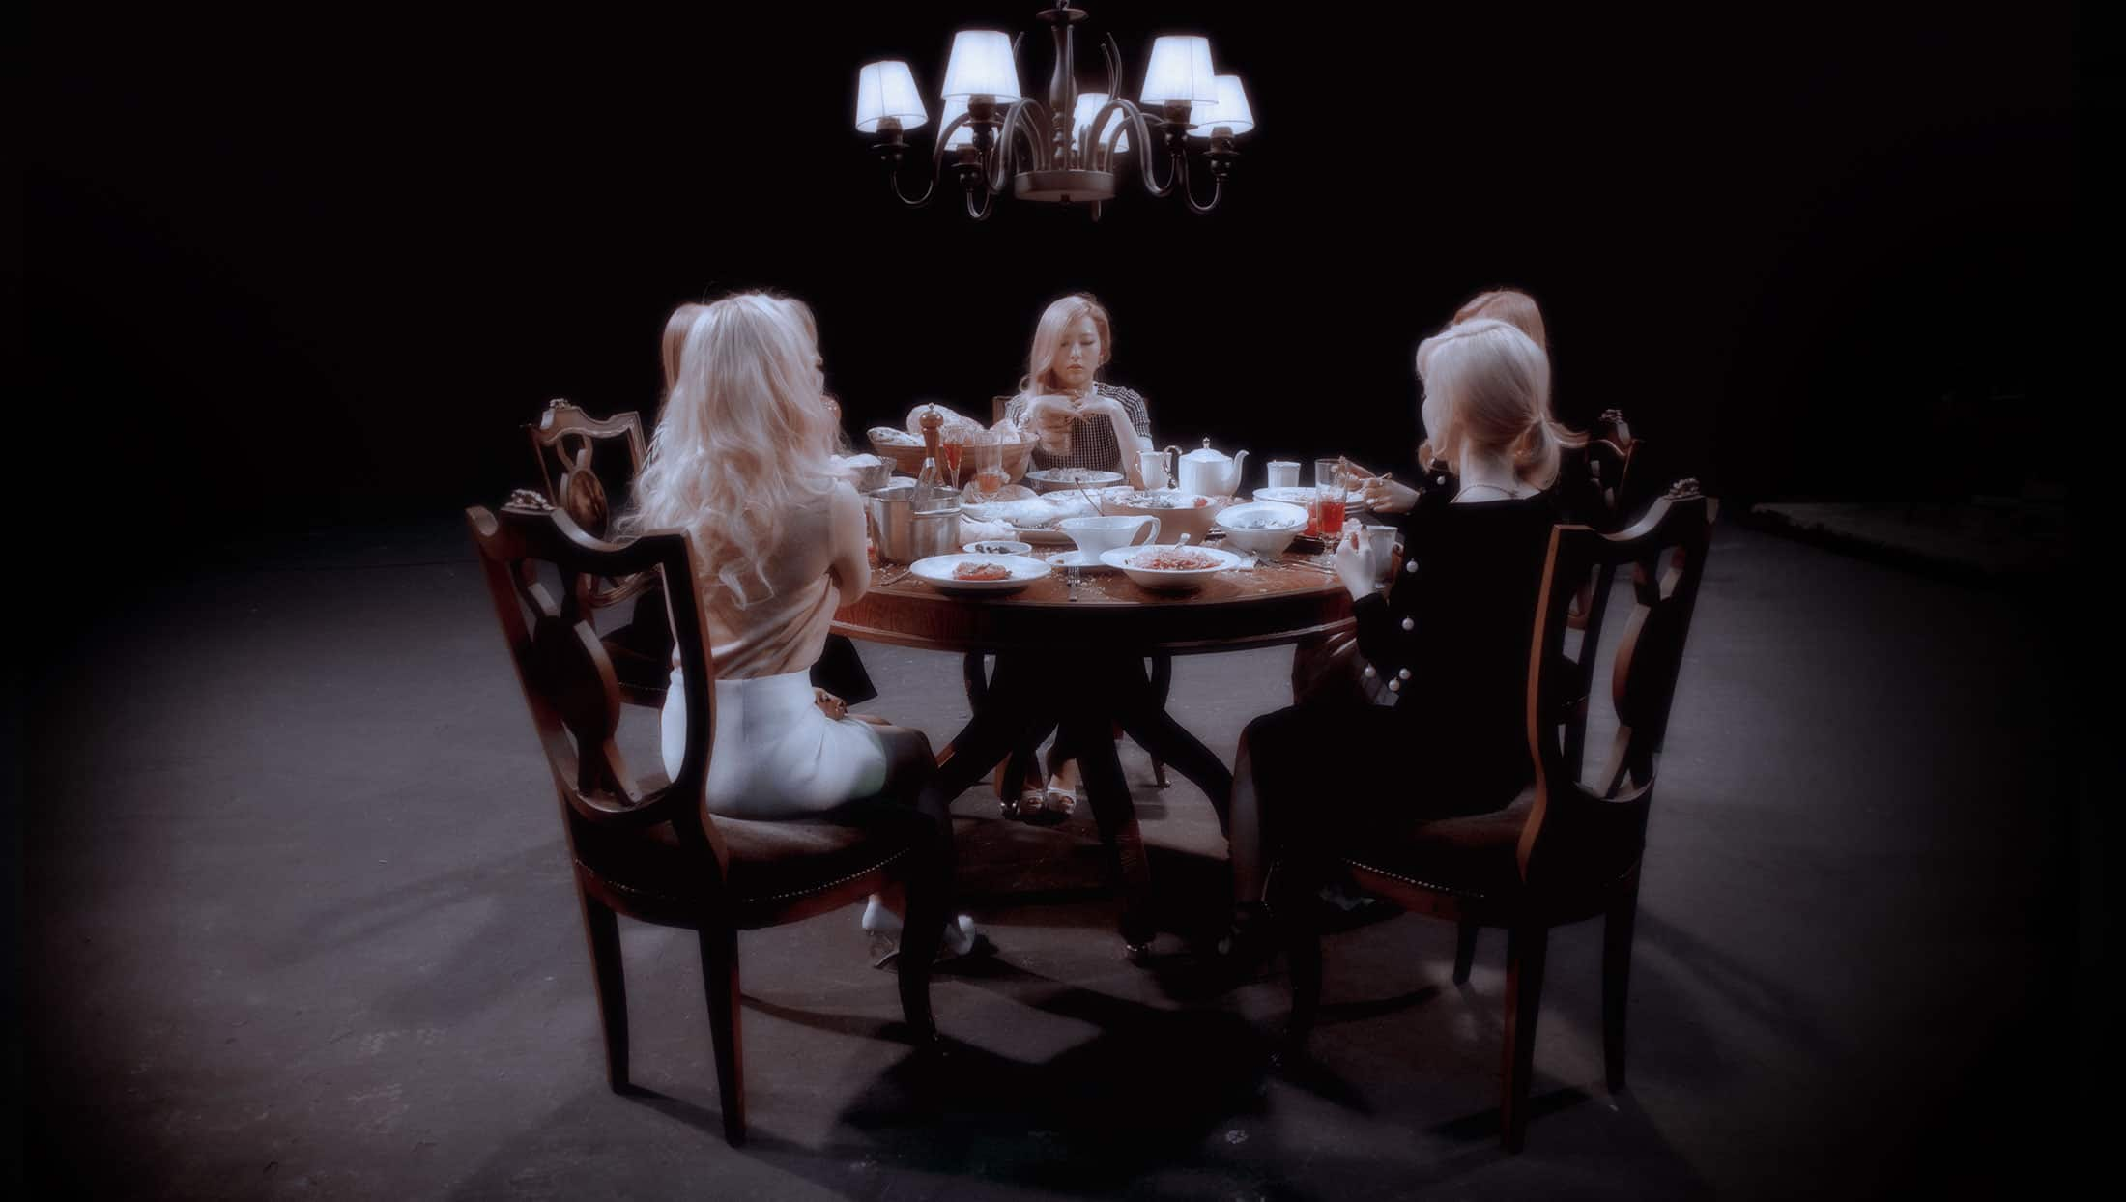


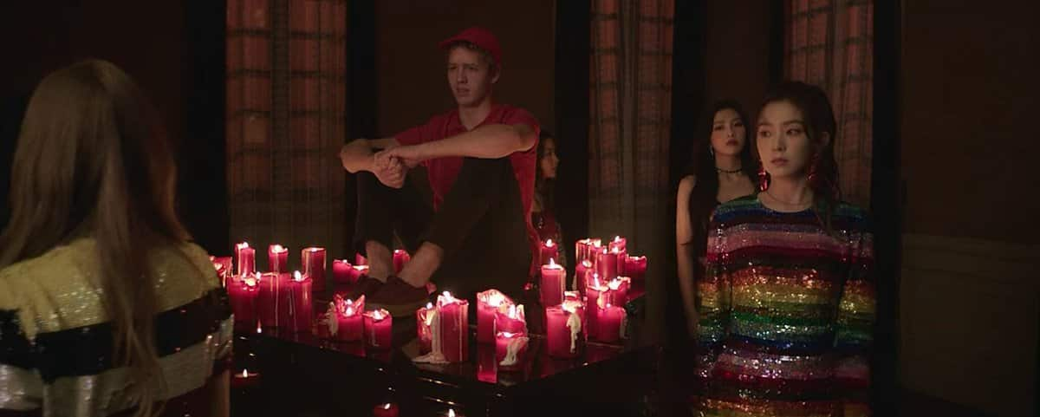
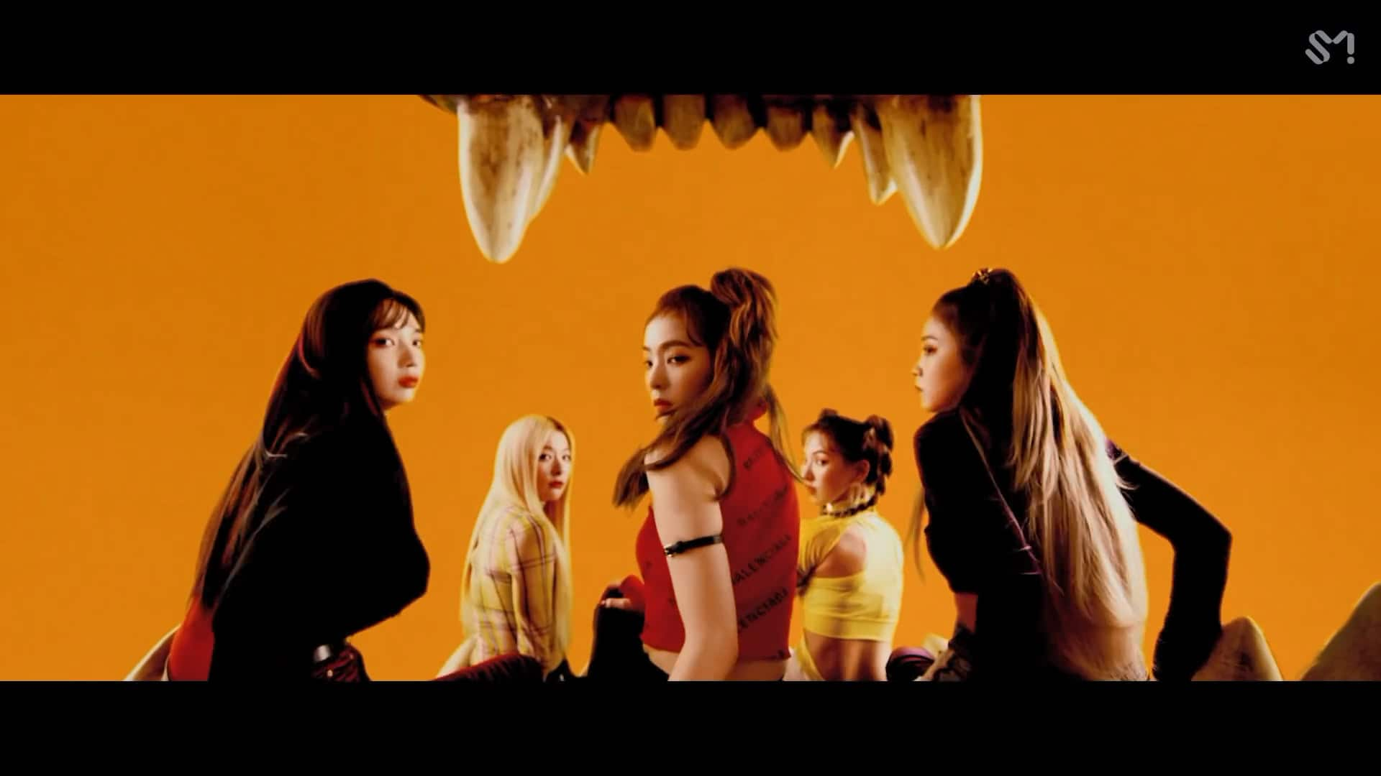
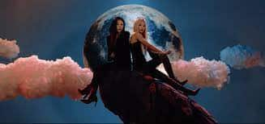
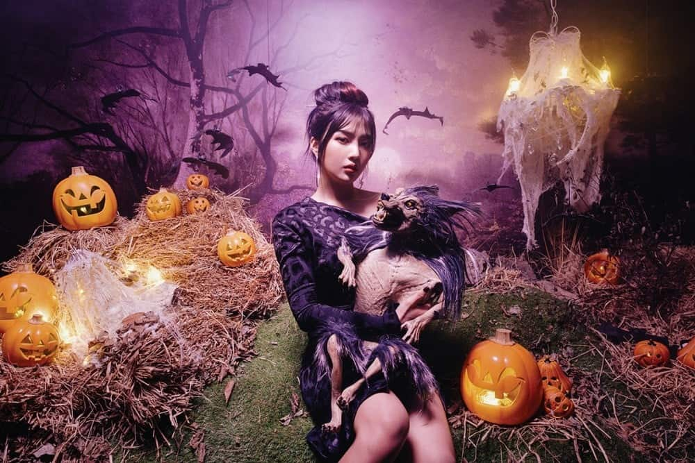
28 REASONS
New releases
Genre
Action
Comedy
Horror
Psychological
Paranormal
Monster
Slasher
Zombie
Gore
Witchcraft
Vampire
Comedy
Drama
Romance
Seulgi is a toxic woman who hurt her man with her attitude, showing red flags that he shouldn’t be ignoring. However, he keeps wanting her. And on the other hand, she claims she has no bad intentions, feeding an ambiguity that doesn’t let him go away.
WATCH NOW
Top rated
PSYCHO
AUTOMATIC

Slide 3



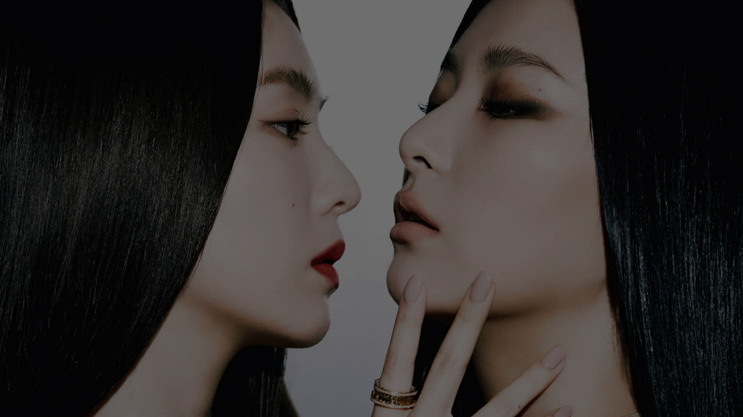

28 REASONS
Seulgi is a toxic woman who hurt her man with her attitude, showing red flags that he shouldn’t be ignoring. However, he keeps wanting her. And on the other hand, she claims she has no bad intentions, feeding an ambiguity that doesn’t let him go away.
WATCH NOW
You may also like
PSYCHO
AUTOMATIC

Slide 4
28 REASONS
Seulgi is a toxic woman who hurt her man with her attitude, showing red flags that he shouldn’t be ignoring. However, he keeps wanting her. And on the other hand, she claims she has no bad intentions, feeding an ambiguity that doesn’t let him go away.
WATCH NOW
You may also like
PSYCHO
AUTOMATIC

Slide 5
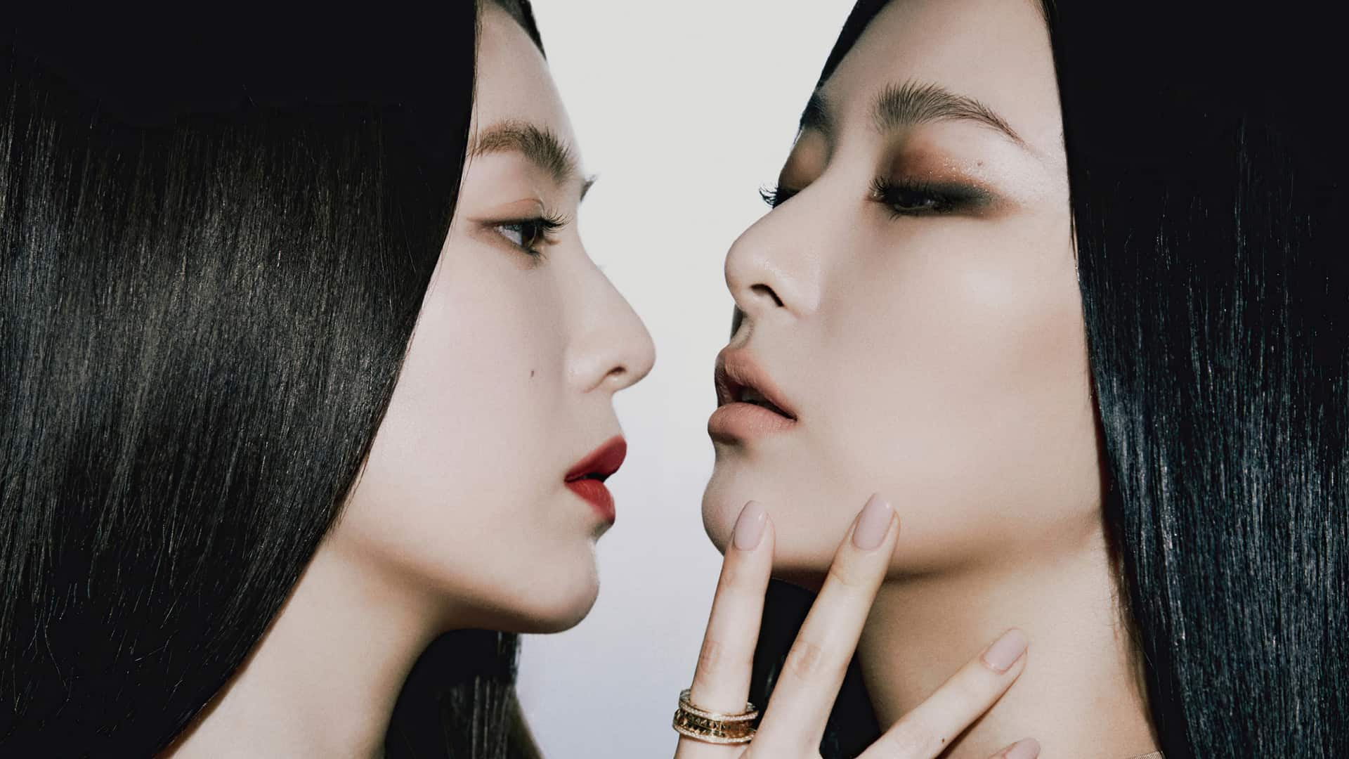
A female vampire that preys on young girls and stalks them in their dreams. Laura couldn’t give Carmilla up and Carmilla couldn’t give up the madness of ‘feeding’ off Laura.
WATCH NOW

Slide 6
PSYCHO
A relationship that is "full of ups and downs" in which a couple "fights so much that they appear crazy in the eyes of others.
WATCH NOW

Slide 7
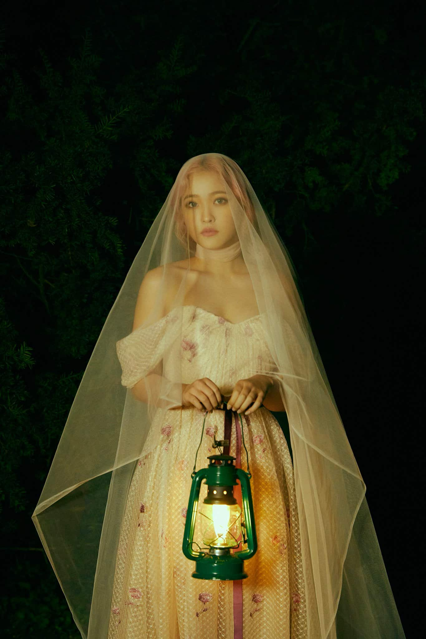
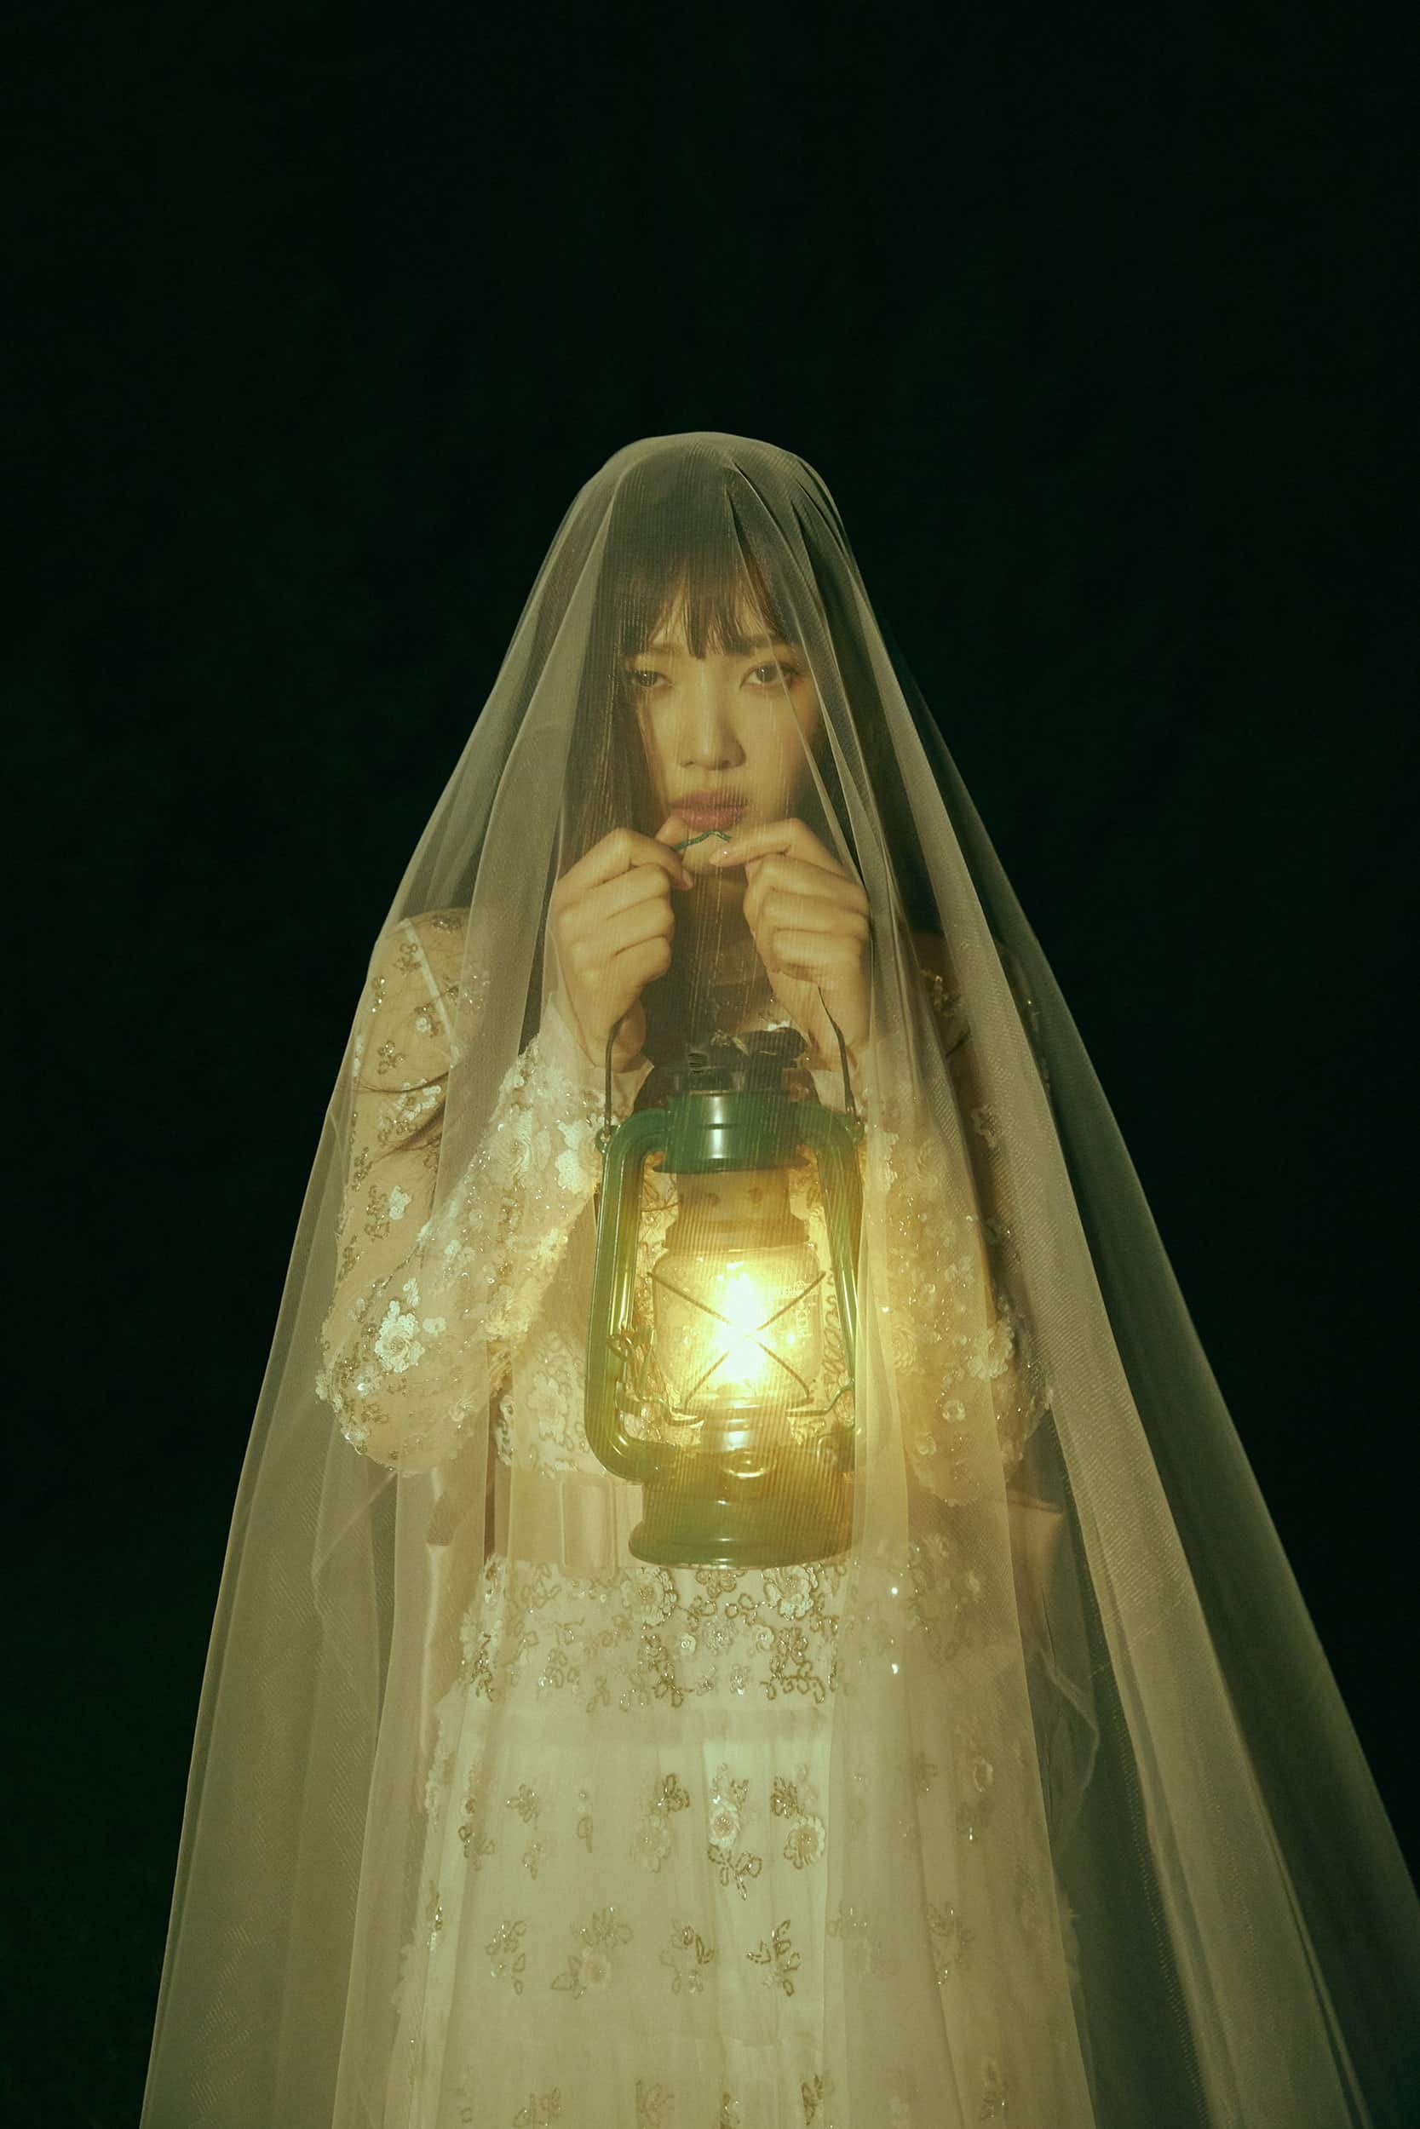
JOY
Cast
Biography
Park Soo Young (박수영; born Sep 3, 1996), better known as Joy, is a South Korean actress, TV host, singer, and member of the Kpop group Red Velvet under SM Entertainment. Joy made her debut with Red Velvet on Aug 1, 2014. Joy entered SM Entertainment in 2012 after passing their global audition. She was the only member of Red Velvet (RV) that was not part of SM Rookies. She trained for 2.5 years before making her official debut with Red Velvet on Aug 1, 2014 at the age of 17.
Park Soo Young
Sep 3, 1996
Virgo

Slide 8
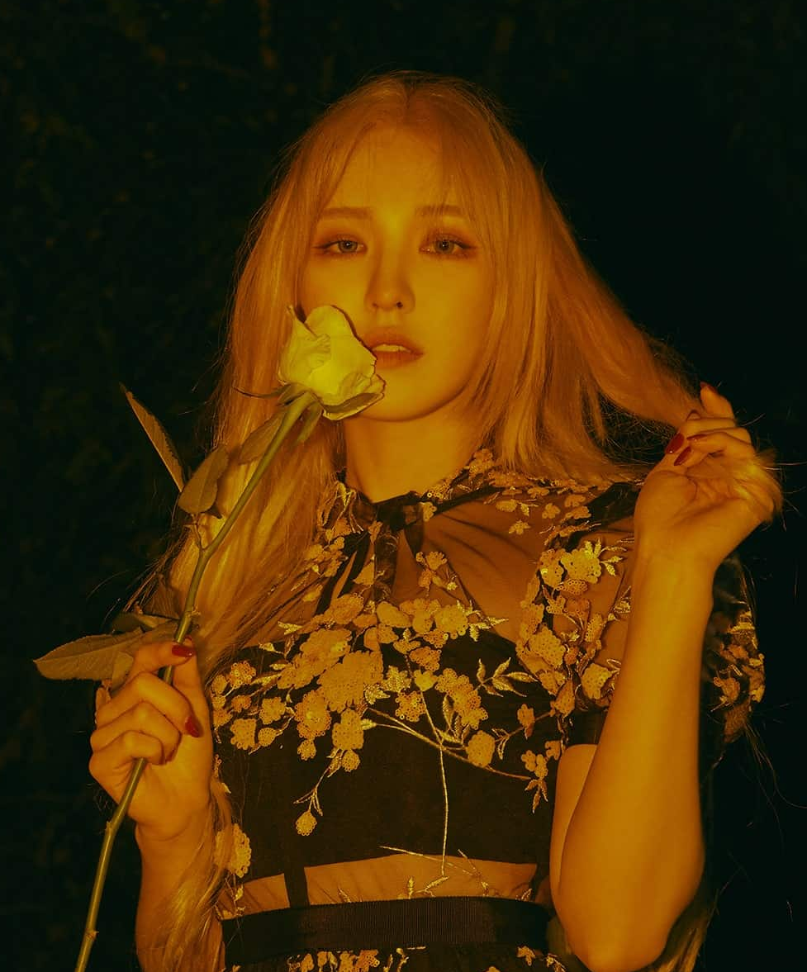
YERI
Cast
Biography
Kim Ye Rim (김예림; born Mar 5, 1999), better known as Yeri, is a South Korean actress, singer, and the youngest member of the Kpop group Red Velvet under SM Entertainment. Yeri made her debut with Red Velvet on March 10, 2015.Yeri joined SM Entertainment after passing an open global audition in 2011. She appeared originally in Red Velvet's Happiness MV as a member of SM Rookies. The video was released in Aug 2014. At the time, she had not debuted with the group yet.
Kim Ye Rim
Mar 5, 1999
Aries

Slide 9
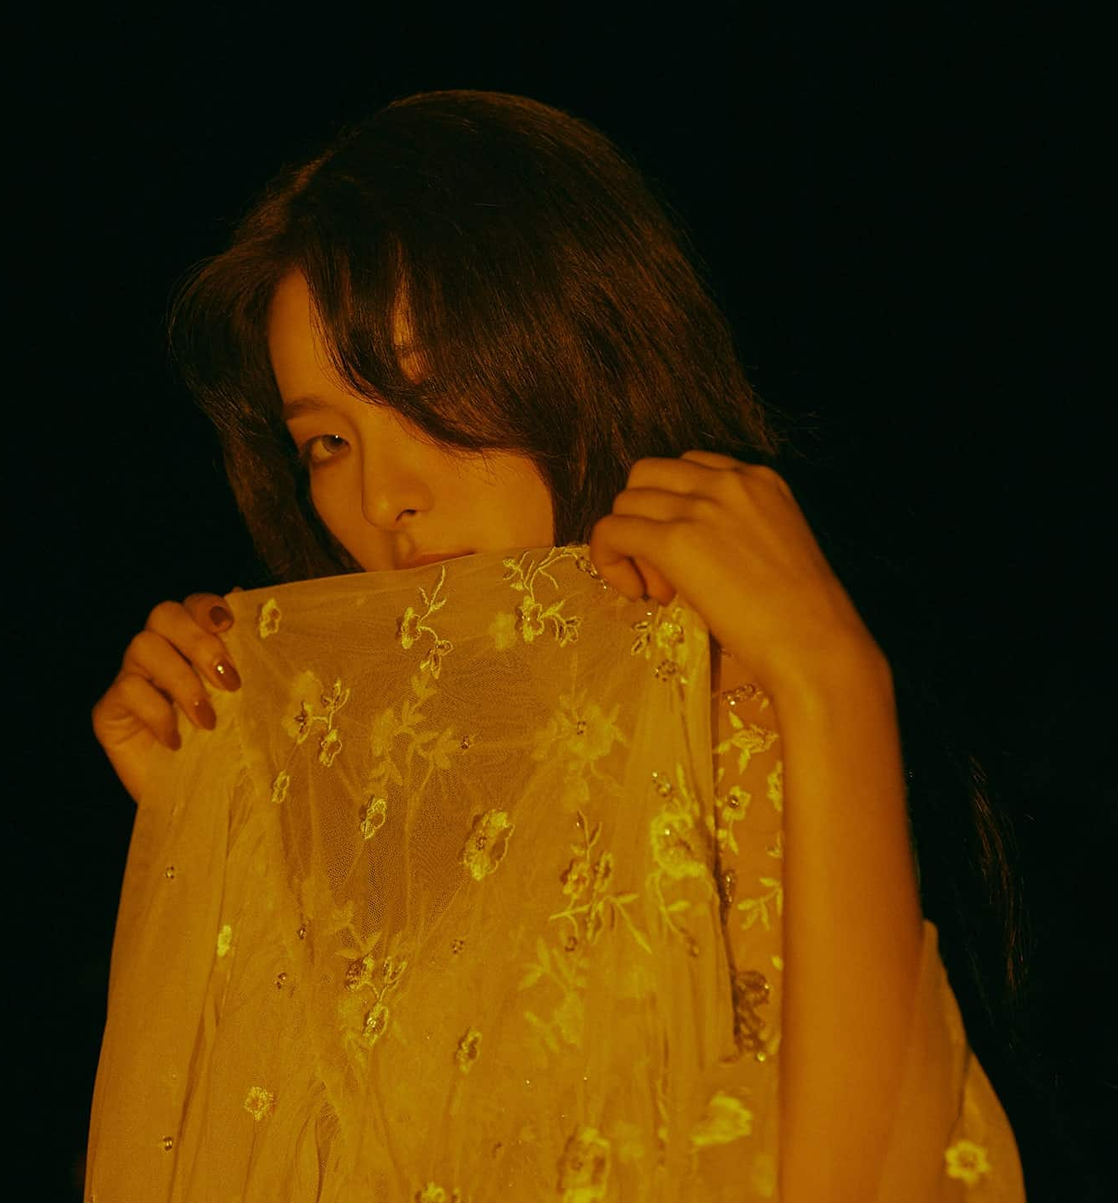
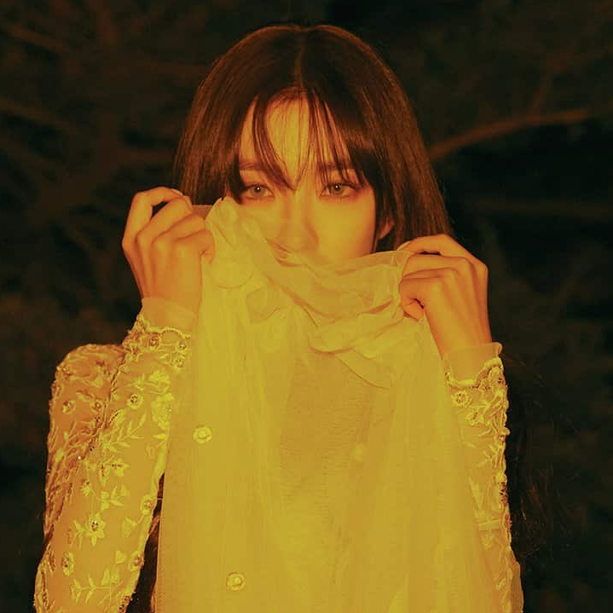
WENDY
Cast
Biography
Son Seung Wan (손승완; also stylized Shon Seung Wan), better known as Wendy, is a South Korean singer and the main vocalist of the Kpop group Red Velvet under SM Entertainment. Wendy made her debut with Red Velvet on Aug 1, 2014. Wendy started dreaming of becoming a singer at the age of 6. She moved to Canada when she was in fifth grade. She later moved to Minnesota, United States from seventh grade to ninth grade.
Son Seung Wan
Feb 21, 1994
Pisces

Slide 10
SEULGI
Cast
Biography
Kang Seul Gi (강슬기; born Feb 10, 1994), simply known as Seulgi, is a South Korean singer, dancer, and member of the Kpop group Red Velvet and the sub-unit Irene & Seulgi under SM Entertainment. Seulgi made her debut with Red Velvet on Aug 1, 2014. Seulgi joined SM Entertainment in 2007 after participating in an open SM audition in 2006. She trained for a total of seven years before her official debut with Red Velvet on Aug 1, 2014 at the age of 20. She is the main dancer and lead vocalist of the group.
Kang Seul Gi
Feb 10, 1994
Aquarius

Slide 11
IRENE
Cast
Biography
Bae Joo Hyun (배주현; born Mar 29, 1991), better known as Irene, is a South Korean actress, rapper, dancer, and the leader of the Kpop group Red Velvet and the sub-unit Irene & Seulgi under SM Entertainment. Irene made her debut with Red Velvet on Aug 1, 2014. Irene joined SM Entertainment in 2009 when she was in her third of high school. In 2013, she was introduced as a member of SM Rookies. She trained for a total of five years before making her official debut as the leader of Red Velvet on Aug 1, 2014.
Bae Joo Hyun
Mar 29, 1991
Aries

Slide 12
They can be awake and aware and innocent. They aren’t good girls gone bad, they’re simply girls capable of complexity and agency.
WATCH NOW

Slide 13
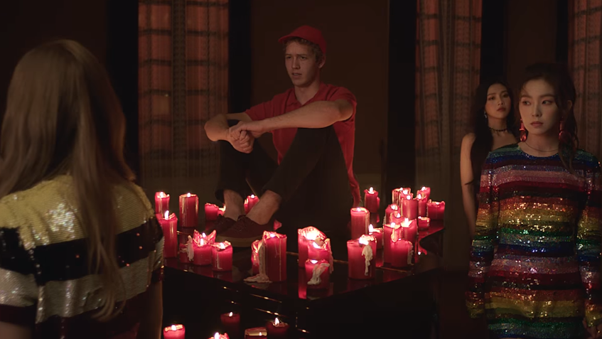
A cat-and-mouse game in which the girls don't want to blatantly express their interest to their crush so instead, they settle for playing hard to get.
WATCH NOW

Slide 14
AUTOMATIC
The lyrics entail the whirlwind of emotions the girls experiences as they feel naturally and automatically drawn to a guy.
WATCH NOW

Slide 15

Red Velvet spend their evening pursuing, and being pursued by, the Big Bad Wolf. While the wolf surprises them in mirrors and scratches the hood of their car, the members also take turns spooking each other.
WATCH NOW

